Slide 1
MACHINE LEARNING

Slide 2
What is Machine Learning ?
Evolved from the study of pattern recognition and computational learning theory in artificial intelligence.
Using statistical techniques to give computer systems the ability to "learn" (e.g., progressively improve performance on a specific task) with data, without being explicitly programmed.

Slide 3
Applications of Machine Learning
Automating automation
Recommendation Systems
Classifications
Text Summarization of images
Face Detection
Face Recognition
Autocomplete

Slide 4
Types of Machine Learning
Supervised Learning
Unsupervised Learning
Reinforcement Learning

Slide 5
Supervised Learning
Each data entry has a corresponding label attached to it.
A data entry can have multiple features but only a single feature which the system predicts after the training of the algorithm being used.
E.g. :
Classifiers
Regression Problems (Predicting some continuous values)

Slide 6
Unsupervised Learning
Any data entry does not have any type of label attached to it.
We generally try to group the data on the basis of their features and then attach some labels to it.
After the above process unsupervised learning problems can ve treated as supervised learning problems
E.g. : Recommendation Systems

Slide 7
Reinforcement Learning
Determines how software agents ought to take actions in an environment so as to maximize some notion of cumulative reward.
For every successful completion of a task, rewards are given
The approach is similar to that of training animals
E.g. : Game playing, Artificial simulations

Slide 8
Our project uses the approach of supervised learning, and the algorithm that we have used is called Convolutional Neural Network (also known as CNNs and ConvNets).
The steps taken to classify flowers we have used are :
1) Image acquisition,
2) Image preprocessing,
3) Image recognition, and
4) Display result

Slide 9
Process Explained Further
Image acquisition : The image dataset is downloaded from Kaggle
URL : https://www.kaggle.com/alxmamaev/flowers-recognition
Image Preprocessing : The size of the images is too large and have different resolutions and aspect ratio so all the images are resized to a resolution of 100x100 pixels and hence to an aspect ratio of 1:1
Image Recognition : A numpy array consisting the R,G,B values of the images is fed to a CNN and it predicts a label (in this case the name of the flower).
Displaying Result : The results are tested on 649 images and validated on the same number of images.

Slide 10
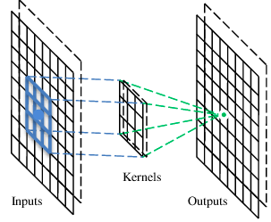
A convolutional layer
A CNN is a neural network with some convolutional layers
(and some other layers). A convolutional layer has a number
of filters that does convolutional operation.
Beak detector
A filter

Slide 11
Convolution
These are the network parameters to be learned.
1 | -1 | -1
-1 | 1 | -1
-1 | -1 | 1
1 | 0 | 0 | 0 | 0 | 1
0 | 1 | 0 | 0 | 1 | 0
0 | 0 | 1 | 1 | 0 | 0
1 | 0 | 0 | 0 | 1 | 0
0 | 1 | 0 | 0 | 1 | 0
0 | 0 | 1 | 0 | 1 | 0
Filter 1
-1 | 1 | -1
-1 | 1 | -1
-1 | 1 | -1
Filter 2
……
6 x 6 image
Each filter detects a small pattern (3 x 3).

Slide 12
Convolution
1 | -1 | -1
-1 | 1 | -1
-1 | -1 | 1
Filter 1
stride=1
1 | 0 | 0 | 0 | 0 | 1
0 | 1 | 0 | 0 | 1 | 0
0 | 0 | 1 | 1 | 0 | 0
1 | 0 | 0 | 0 | 1 | 0
0 | 1 | 0 | 0 | 1 | 0
0 | 0 | 1 | 0 | 1 | 0
Dot
product
3
-1
6 x 6 image

Slide 13
Convolution
1 | -1 | -1
-1 | 1 | -1
-1 | -1 | 1
Filter 1
If stride=2
1 | 0 | 0 | 0 | 0 | 1
0 | 1 | 0 | 0 | 1 | 0
0 | 0 | 1 | 1 | 0 | 0
1 | 0 | 0 | 0 | 1 | 0
0 | 1 | 0 | 0 | 1 | 0
0 | 0 | 1 | 0 | 1 | 0
3
-3
6 x 6 image

Slide 14
Convolution
1 | -1 | -1
-1 | 1 | -1
-1 | -1 | 1
Filter 1
stride=1
1 | 0 | 0 | 0 | 0 | 1
0 | 1 | 0 | 0 | 1 | 0
0 | 0 | 1 | 1 | 0 | 0
1 | 0 | 0 | 0 | 1 | 0
0 | 1 | 0 | 0 | 1 | 0
0 | 0 | 1 | 0 | 1 | 0
3
-1
-3
-1
-3
1
0
-3
-3
-3
0
1
3
-2
-2
-1
6 x 6 image

Slide 15
Convolution
-1 | 1 | -1
-1 | 1 | -1
-1 | 1 | -1
Filter 2
stride=1
Repeat this for each filter
1 | 0 | 0 | 0 | 0 | 1
0 | 1 | 0 | 0 | 1 | 0
0 | 0 | 1 | 1 | 0 | 0
1 | 0 | 0 | 0 | 1 | 0
0 | 1 | 0 | 0 | 1 | 0
0 | 0 | 1 | 0 | 1 | 0
3
-1
-3
-1
-1
-1
-1
-1
-3
1
0
-3
-1
-1
-2
1
Feature
Map
-3
-3
0
1
-1
-1
-2
1
3
-2
-2
-1
6 x 6 image
-1
0
-4
3
Two 4 x 4 images
Forming 2 x 4 x 4 matrix

Slide 16
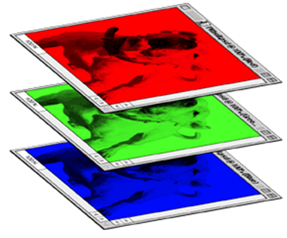
Color image: RGB 3 channels
1 | -1 | -1
-1 | 1 | -1
-1 | -1 | 1
-1 | 1 | -1
-1 | 1 | -1
-1 | 1 | -1
1 | -1 | -1
-1 | 1 | -1
-1 | -1 | 1
-1 | 1 | -1
-1 | 1 | -1
-1 | 1 | -1
1 | -1 | -1
-1 | 1 | -1
-1 | -1 | 1
-1 | 1 | -1
-1 | 1 | -1
-1 | 1 | -1
Filter 1
Filter 2
Color image
1 | 0 | 0 | 0 | 0 | 1
0 | 1 | 0 | 0 | 1 | 0
0 | 0 | 1 | 1 | 0 | 0
1 | 0 | 0 | 0 | 1 | 0
0 | 1 | 0 | 0 | 1 | 0
0 | 0 | 1 | 0 | 1 | 0
1 | 0 | 0 | 0 | 0 | 1
0 | 1 | 0 | 0 | 1 | 0
0 | 0 | 1 | 1 | 0 | 0
1 | 0 | 0 | 0 | 1 | 0
0 | 1 | 0 | 0 | 1 | 0
0 | 0 | 1 | 0 | 1 | 0
1 | 0 | 0 | 0 | 0 | 1
0 | 1 | 0 | 0 | 1 | 0
0 | 0 | 1 | 1 | 0 | 0
1 | 0 | 0 | 0 | 1 | 0
0 | 1 | 0 | 0 | 1 | 0
0 | 0 | 1 | 0 | 1 | 0

Slide 17
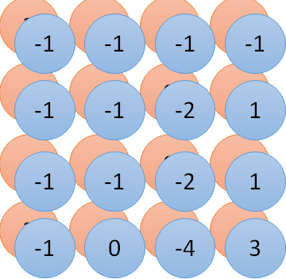
Convolution v.s. Fully Connected
1 | 0 | 0 | 0 | 0 | 1
0 | 1 | 0 | 0 | 1 | 0
0 | 0 | 1 | 1 | 0 | 0
1 | 0 | 0 | 0 | 1 | 0
0 | 1 | 0 | 0 | 1 | 0
0 | 0 | 1 | 0 | 1 | 0
1 | -1 | -1
-1 | 1 | -1
-1 | -1 | 1
-1 | 1 | -1
-1 | 1 | -1
-1 | 1 | -1
convolution
image
1 | 0 | 0 | 0 | 0 | 1
0 | 1 | 0 | 0 | 1 | 0
0 | 0 | 1 | 1 | 0 | 0
1 | 0 | 0 | 0 | 1 | 0
0 | 1 | 0 | 0 | 1 | 0
0 | 0 | 1 | 0 | 1 | 0
Fully-connected
……
……

Slide 18
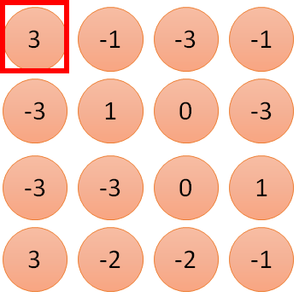
1 | -1 | -1
-1 | 1 | -1
-1 | -1 | 1
1
1
Filter 1
2
0
3
0
3
4:
0
1 | 0 | 0 | 0 | 0 | 1
0 | 1 | 0 | 0 | 1 | 0
0 | 0 | 1 | 1 | 0 | 0
1 | 0 | 0 | 0 | 1 | 0
0 | 1 | 0 | 0 | 1 | 0
0 | 0 | 1 | 0 | 1 | 0
…
0
8
1
9
0
10:
0
…
13
0
6 x 6 image
14
0
fewer parameters!
15
Only connect to 9 inputs, not fully connected
1
16
1
…

Slide 19
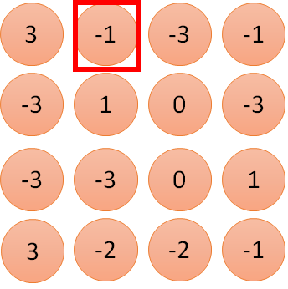
1 | -1 | -1
-1 | 1 | -1
-1 | -1 | 1
1:
1
Filter 1
2:
0
3:
0
3
4:
0
1 | 0 | 0 | 0 | 0 | 1
0 | 1 | 0 | 0 | 1 | 0
0 | 0 | 1 | 1 | 0 | 0
1 | 0 | 0 | 0 | 1 | 0
0 | 1 | 0 | 0 | 1 | 0
0 | 0 | 1 | 0 | 1 | 0
…
7:
0
8:
1
-1
9:
0
10:
0
…
13:
0
6 x 6 image
14:
0
Fewer parameters
15:
1
16:
1
Shared weights
Even fewer parameters
…

Slide 20
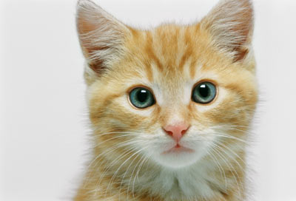
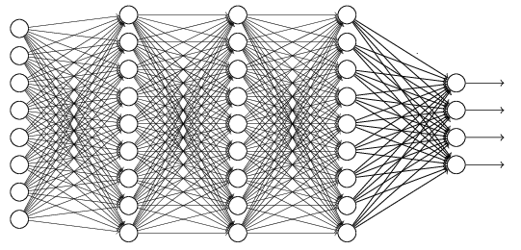
The whole CNN
cat dog ……
Convolution
Max Pooling
Can repeat many times
Fully Connected Feedforward network
Convolution
Max Pooling
Flattened

Slide 21
Max Pooling
1 | -1 | -1
-1 | 1 | -1
-1 | -1 | 1
-1 | 1 | -1
-1 | 1 | -1
-1 | 1 | -1
Filter 1
Filter 2
3
-1
-3
-1
-1
-1
-1
-1
-3
1
0
-3
-1
-1
-2
1
-3
-3
0
1
-1
-1
-2
1
3
-2
-2
-1
-1
0
-4
3

Slide 22
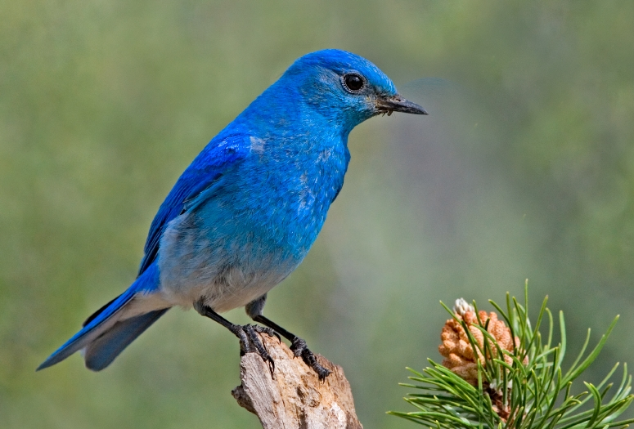

Why Pooling
Subsampling pixels will not change the object
bird
bird
Subsampling
We can subsample the pixels to make image smaller
fewer parameters to characterize the image

Slide 23
A CNN compresses a fully connected network in two ways:
Reducing number of connections
Shared weights on the edges
Max pooling further reduces the complexity

Slide 24
Max Pooling
New image
but smaller
1 | 0 | 0 | 0 | 0 | 1
0 | 1 | 0 | 0 | 1 | 0
0 | 0 | 1 | 1 | 0 | 0
1 | 0 | 0 | 0 | 1 | 0
0 | 1 | 0 | 0 | 1 | 0
0 | 0 | 1 | 0 | 1 | 0
Conv
3
0
-1
1
Max
Pooling
3
1
0
3
2 x 2 image
6 x 6 image
Each filter
is a channel

Slide 25
The whole CNN
3
0
-1
1
Convolution
3
1
0
3
Max Pooling
Can repeat many times
A new image
Convolution
Smaller than the original image
The number of channels is the number of filters
Max Pooling

Slide 26
The whole CNN
cat dog ……
Convolution
Max Pooling
Fully Connected Feedforward network
A new image
Convolution
Max Pooling
Flattened
A new image

Slide 27
Flattening
3
0
1
3
0
-1
1
3
3
1
-1
0
3
Flattened
1
Fully Connected Feedforward network
0
3

Slide 28


CNN in Keras
Only modified the network structure and input format (vector -> 3-D tensor)
input
Convolution
1 | -1 | -1
-1 | 1 | -1
-1 | -1 | 1
-1 | 1 | -1
-1 | 1 | -1
-1 | 1 | -1
There are 25 3x3 filters.
……
Max Pooling
Input_shape = ( 28 , 28 , 1)
28 x 28 pixels
1: black/white, 3: RGB
Convolution
3
-1
3
Max Pooling
-3
1

Slide 29
CNN in Keras
Only modified the network structure and input format (vector -> 3-D array)
Input
1 x 28 x 28
Convolution
How many parameters for each filter?
9
25 x 26 x 26
Max Pooling
25 x 13 x 13
Convolution
How many parameters
for each filter?
225=
25x9
50 x 11 x 11
Max Pooling
50 x 5 x 5

